Slide 1
New Paradigms for Measuring Savings

Slide 2
SEE Action EM&V Working Group
“Transform EM&V to yield more accurate, credible, and timely results that accelerate deployment and improve management of energy efficiency.”

Slide 3
Building a portfolio
Clean Energy Standard
Interconnection Planning

Slide 4
Uniform Methods Project
Why Is This Project Needed?
There are multiple ways to calculate energy savings for the same energy efficiency project or program.
Lack of consistency leads to difficulty comparing results.
Same efficiency measure can yield differing savings results depending on the protocol used to calculate savings
There is a general lack of transparency about the assumptions and details of savings calculations.
Result is reduced credibility for reported savings, and custom designed protocols.

Slide 5
Project Goals
Bring Uniformity and Transparency to Energy Savings Calculations for Energy Efficiency Programs
Strengthen the credibility of savings calculations through greater consistency and transparency.
Simplify the comparison of savings across similar efficiency programs and measures in different jurisdictions.
Reduce the costs of evaluation, measurement, and verification (EM&V).

Slide 6
What Is This Project?
Develop and Publish 15–20 Protocols for Calculating Savings from Energy Efficiency Measures
Addresses most common residential and commercial efficiency measures in ratepayer funded programs:
Residential lighting • Commercial Lighting
Commercial unitary air conditioning • Refrigerator replacement
Presents step-by-step calculations for determining gross savings
Adoption is voluntary

Slide 7
What Is This Project?
Protocols Developed In Collaboration With EM&V Industry and Major Energy Efficiency Stakeholders
Protocols developed in collaboration with energy efficiency program administrators, stakeholders, and EM&V consultants
Including the major U.S. firms
that do as many as 70% of
energy efficiency evaluations

Slide 8
Project Organization
Timeline
The first set of protocols has been completed and are out for stakeholder review until August 17, 2012.
7 protocols (commercial lighting, commercial lighting controls, commercial unitary AC, residential furnaces and boilers, residential lighting, refrigerator recycling, residential whole-building retrofit)
6 evaluation issues (metering, net to gross, peak impacts, surveys, sampling, other issues)
First set of 7 protocols completed in late 2012
Second set of 10 protocols publish in 2013

Slide 9
Future Protocols
Commercial HVAC Controls — Energy Management Systems/Direct Digital Control systems
Residential New Construction
Commercial Air Compressors
Residential Behavioral Programs
Data Center Efficiency — ENERGY STAR® Servers/Virtualization, Efficient Storage/Uninterruptable Power Supplies
Residential and Commercial High Efficiency Water Heaters

Slide 10
The Protocols
Easy-to-follow protocols based on commonly accepted engineering and statistical methods for determining gross savings for a core set of commonly deployed energy efficiency measures. The protocols also include:
A description of measure and application conditions
An algorithm for estimating savings
An example of a typical program offering and alternative delivery strategies
Considerations for the measurement and verification process, including an International Performance Verification and Measurement Protocol option
Data requirements for verification and recommended collection methods
Recommended program evaluation elements
Fall-back options for lower-cost EM&V approaches

Slide 11
Lowering Costs
Standardized versus custom approaches
Clear data collection requirements
Protocols are most applicable to large programs
Smaller program/utilities will continue to rely on less rigorous methods that are less costly
Will lead to the development of UMP technical reference manuals and deemed savings values based on UMP protocols

Slide 12
Benefits
Greater Consistency of Savings Calculations
Increases credibility of savings estimates
Makes it easier and less costly for to quickly establish good EM&V practices because they no longer have to start from scratch
Simplifies comparison of savings resulting from similar programs in different jurisdictions
Helps utilities and program administrators manage regulatory risk
Allows administrators to set data requirements early on, improving the alignment between implementation and evaluation.
Energy efficiency programs that adopt the protocols will have greater confidence in setting and meeting savings targets as part of larger energy efficiency initiatives.

Slide 13
Buildings Performance Database Overview
This document is confidential and is intended solely for the use and information of the audience to whom it is addressed.

Slide 14
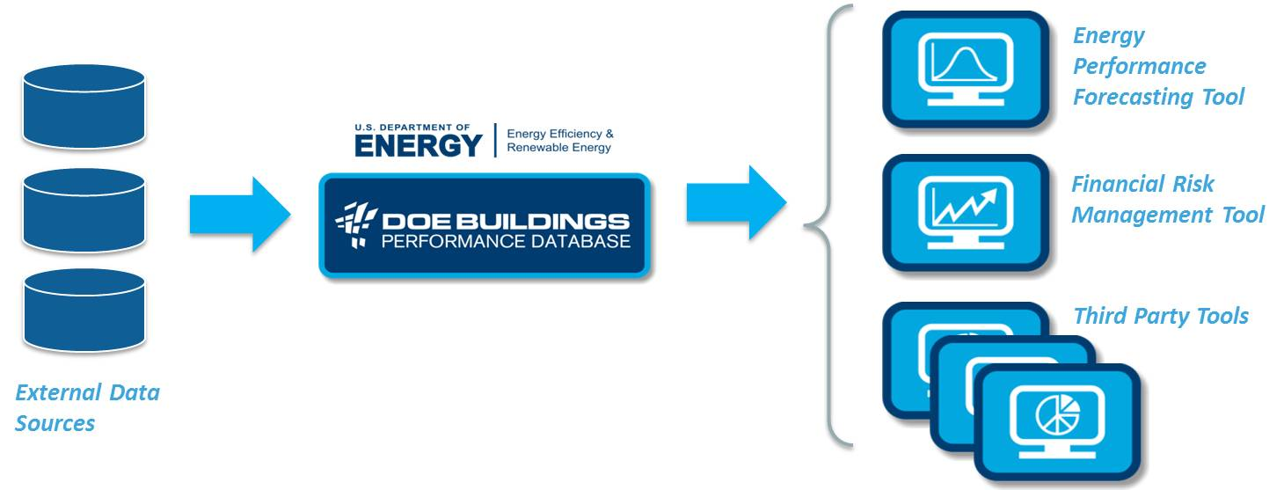
Overview
The Buildings Performance Database is a dataset with information about real buildings’ physical and operational characteristics and energy consumption.
The BPD will help transform the market by increasing the amount of information available to decision-makers.

Slide 15
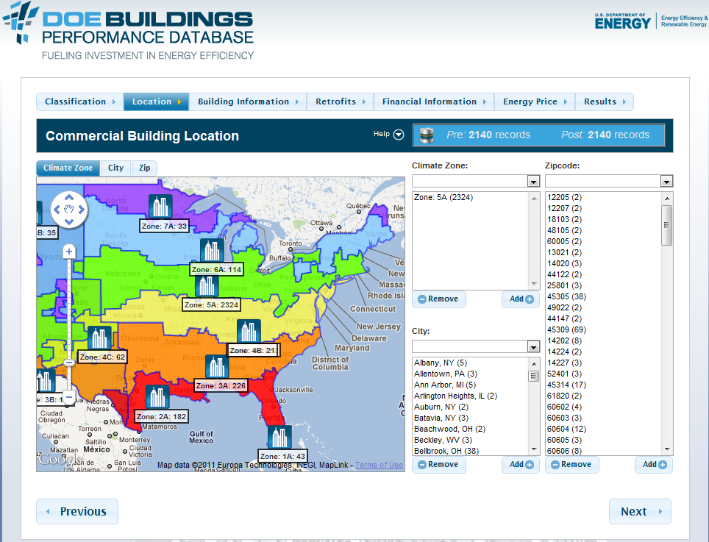
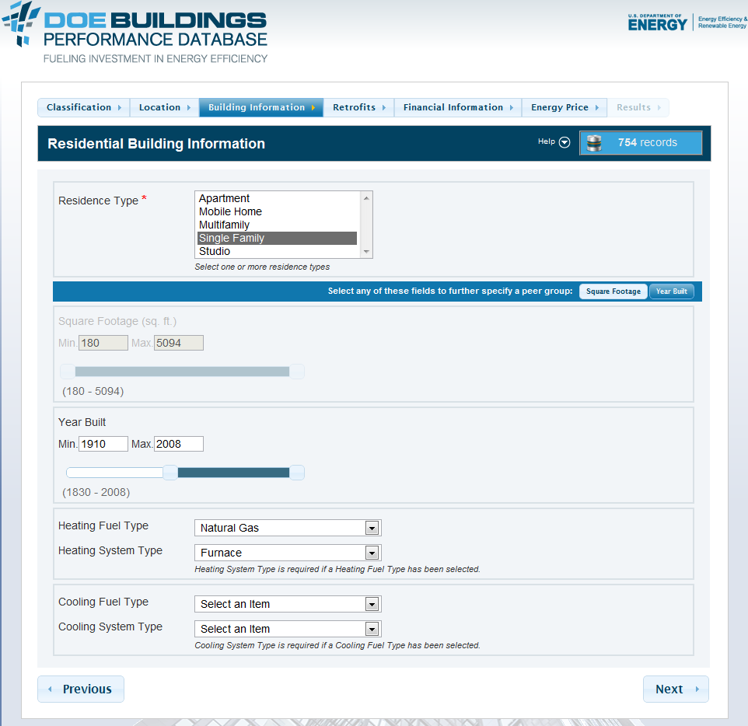
Overview
The BPD enables comparison of groups of buildings based on variables such as use, location, size, and equipment type.

Slide 16
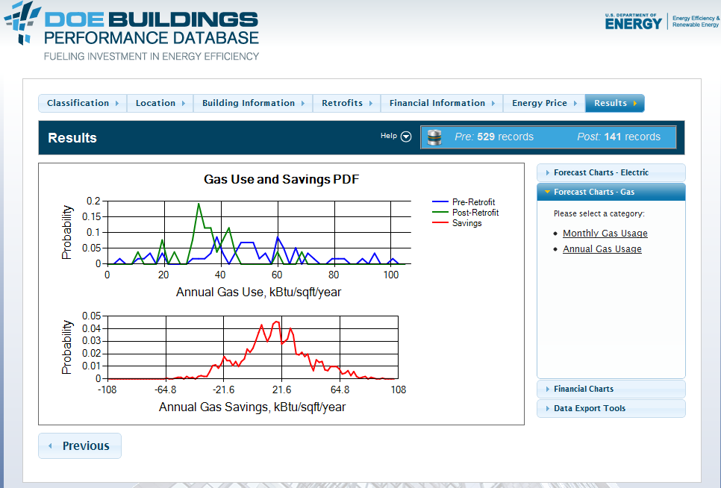
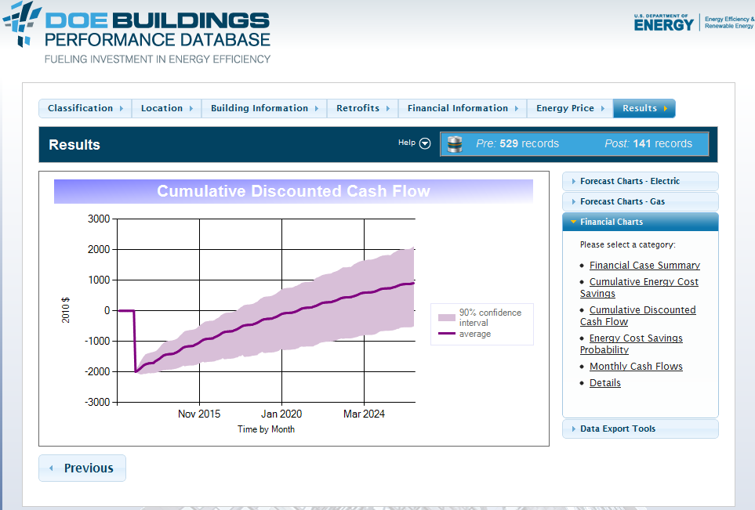
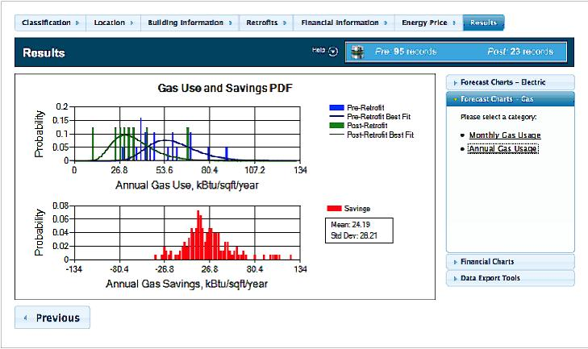
Overview
The BPD can be analyzed at a portfolio level, using actuarial methods.
The analytical tools quantify the energy and financial performance, and risk distributions, of specific building improvements.
Residential Heating Retrofit
Annual Natural Gas Usage
Annual Gas Use )(kBTu/sqft/yr)
Annual Gas Savings
Energy Savings Analysis
Cumulative Cash Flow Analysis

Slide 17
Uniform Methods Project
Michael.Li@ee.doe.gov
SEE Action EM&V Working Group
Carla.Frisch@ee.doe.gov
Building Performance Database
WilliamC.Miller@ee.doe.gov
Cody.Taylor@ee.doe.gov

